Slide 1
Visiting Student Application Service (VSAS)
Student Software Screenshots

Slide 2
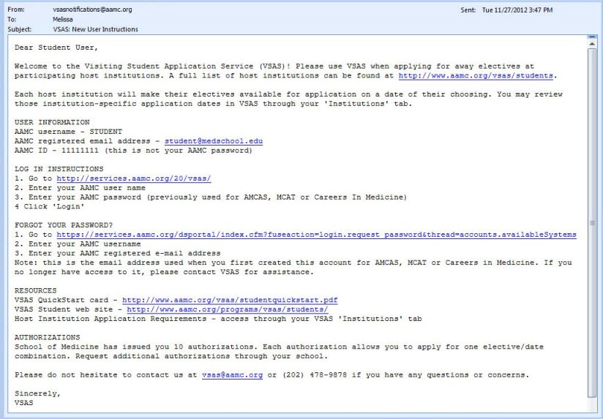
Step 1: Receive VSAS Authorizations
Request authorizations from your visiting student coordinator or student affairs office.
You will then receive a “VSAS: New User Instructions” e-mail with login information.

Slide 3
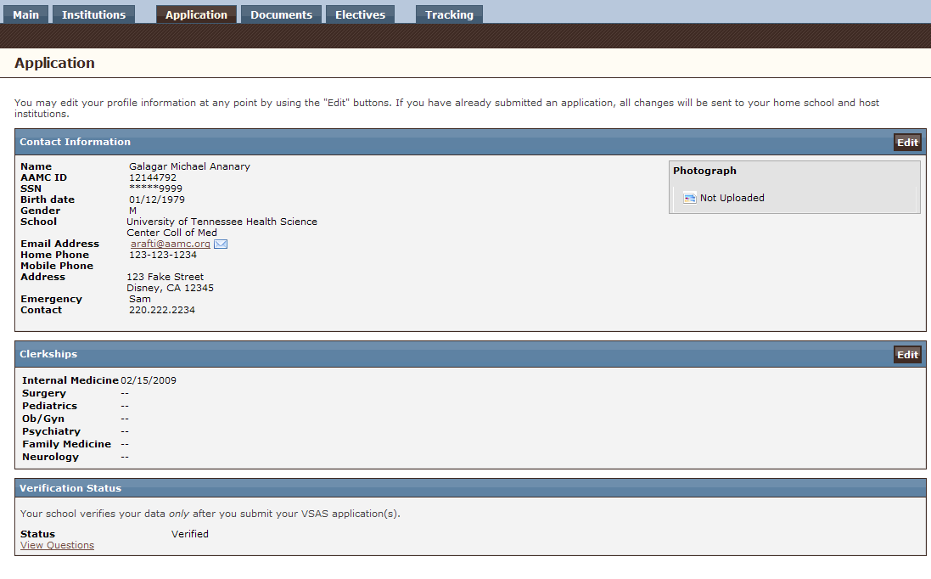
Step 2: Complete Application Profile
Provide general contact information, including core clerkship completion dates.

Slide 4
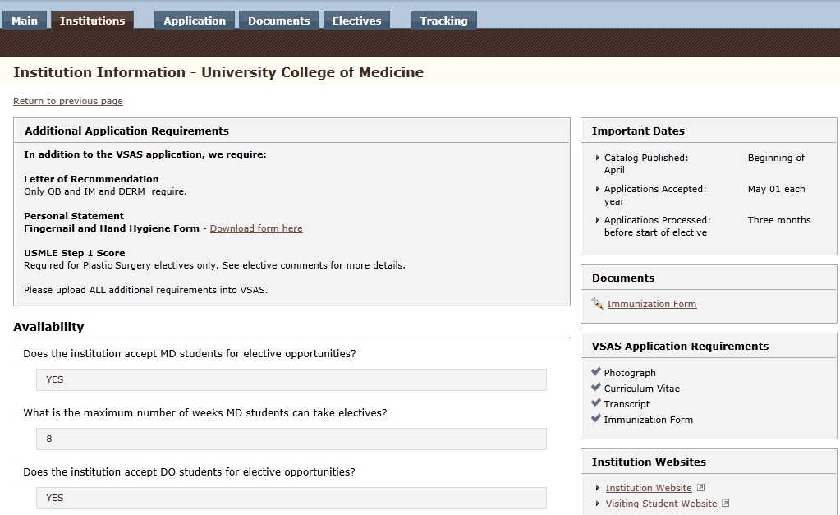
Step 3: Review Host Institution Info
Use the “Institutions” tab to review the application requirements and date on which a VSAS host
institution will post their electives and begin accepting applications.

Slide 5
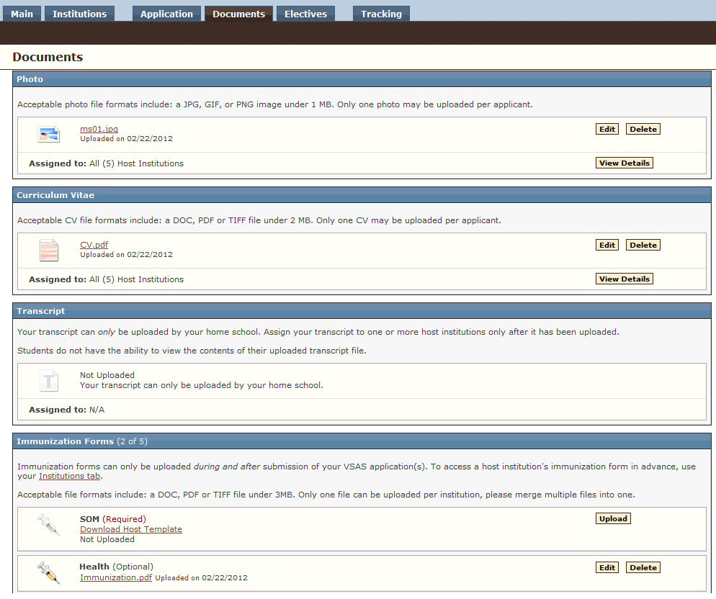
Step 4: Upload & Assign Documents
Use the “Documents” tab to upload your CV, photo, immunization forms, and supplemental documentation. Assign those documents to a specific host institution or elective application.

Slide 6
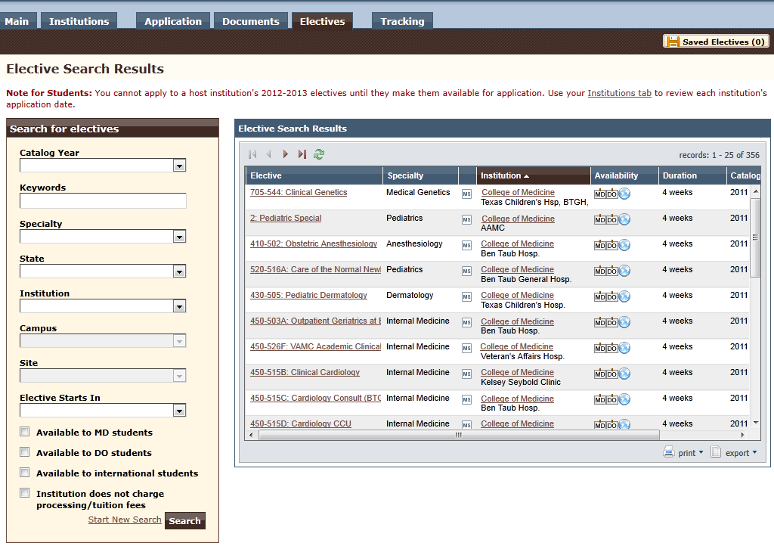
Step 5: Search for Electives
Browse electives at the VSAS host institutions once the institutions post their electives
for review and application.

Slide 7
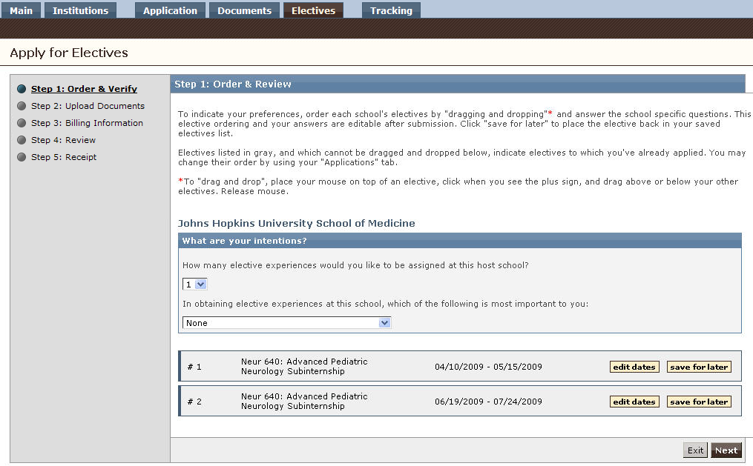
Step 6: Apply to Electives
Submit your applications by indicating your preferred order of elective requests, assign documents to applications, and submit your billing information for VSAS fees.

Slide 8
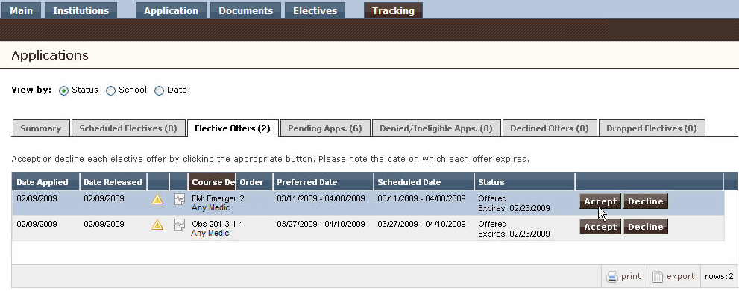
Step 7: Track Offers
Log in to VSAS to review your pending applications and accept or decline received offers.

Slide 9


